Slide 1

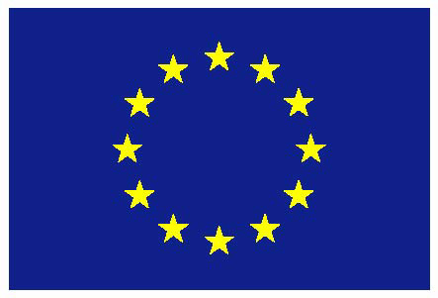
Tax-based own resources for the EU Budget
Margit Schratzenstaller
Austrian Institute of Economic Research WIFO
FairTax Stakeholder Event Brussels, February 19, 2019
The project is funded by the European Union’s Horizon 2020 research and innovation programme 2014-2018, grant agreement No. FairTax 649439

Slide 2
Long-term challenges for EU Budget
Persisting regional disparities
Demographic change
Increasing income and wealth inequality and risk of poverty
Refugee migration
(Youth) unemployment
Recent and imminent enlargement rounds
Climate change and energy transition
Technological change
=> Current structure of EU budget not able to cope with these challenges

Slide 3
Lessons to be learned from mff 2014-2020
MFF 2014-2020 contributes too little to overarching goal of sustainable growth and development
Europe 2020 Strategy
2030 Agenda for Sustainable Development, SDGs
Paris Climate Agreement
Action Plan Circular Economy
Action Plan for Fair and Efficient Corporate Taxation
...
=> Need for reform regarding EU expenditures as well as own resources to finance EU budget!

Slide 4
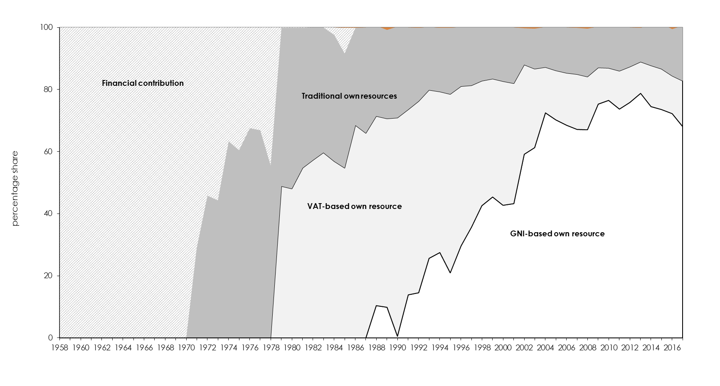
Reform of System of OR
Composition of own resources in a long-term perspective
Source: European Commission (2018).

Slide 5
Reform of System of OR
Existing system of own resources contributes little to European sustainability goals
Current own resources should be (partially) replaced by sustainability-oriented tax-based own resources (TBOR)
Candidates: Taxes that cannot be enforced effectively on MS level due to tax competition, tax avoidance, cross-border externalities…
Would create space for Member States to cut more harmful taxes (labour taxes)
Would enable a fiscally neutral, but sustainability-enhancing tax shift at Member State level

Slide 6
Candidates for TBOR and potential revenues

Slide 7
Sustainability-oriented evaluation criteria
Economic sustainability
Growth friendliness, sufficiency/fiscal sustainability
Social sustainability
Personal distribution
Environmental sustainability
Institutional sustainability
Short-term revenue stability, non-attributability of revenues to individual Member States, fair distribution of tax burden across Member States, contribution to tax harmonization, non-interference with Member States’ tax systems, visibility

Slide 8
evaluation of candidates for Tax-Based Own Resources
Potential tax-based own resource | growth friendliness | sufficiency | personal distribution | environmental sustainability | non-attributability
Carbon-based flight ticket tax | - | + | ? | + | +
Border carbon adjustment | ? | + | - | + | +
Supplement to national fuel tax | - | + | ? | + | +
Net wealth tax | + | + | + | 0 | -
FTT | + | + | + | 0 | +
CCCTB | ? | + | ? | 0 | -
+ positive contribution; – negative contribution; – 0 neutral; ? unclear/not known.

Slide 9
evaluation of candidates for Tax-Based Own Resources
Potential tax-based own resource | short-term revenue stability | tax harmonization | non-interference | visibility | contribution to EU strategies
Carbon-based flight ticket tax | + | + | (+) | + | +
Border carbon adjustment | + | + | + | - | +
Supplement to national fuel tax | + | 0 | + | + | +
Net wealth tax | + | + | + | + | +
FTT | + | + | + | - | +
CCCTB | - | + | - | - | +
+ positive contribution; – negative contribution; – 0 neutral; ? unclear/not known.

Slide 10
EC Proposals from may 2018
First steps towards tax-based own resources
Share of 3% in CCCTB
Tax rate of 0.80 € per kilo non-recyclable plastic waste
Share of 20% in revenues from auctioning emission trading certificates
=> 12% of overall revenues by 2027 – thus reducing share of national contributions from above 80% to 71%

Slide 11
Further research questions
What are the determinants of support or opposition of Member States regarding the implementation of tax-based own resources?
Analysis of further options for tax-based own resources contributing to current EU initiatives and strategies
Taxes to support a circular economy (plastic tax, resource taxes…)

Slide 12
Conclusions and outlook
Comprehensive sustainability-orientation of EU budget could be key element to contribute to important European strategies
TBOR could be implemented within given legal framework
Use momentum created by current reflections on flaws in E(M)U architecture, future of EU finances, integration scenarios to push radical reforms in EU budget
Brexit shock – opportunity to fundamentally reform structure of EU budget
Importance of package deals!

Slide 13
References
Krenek, A., Schratzenstaller, M. 2018. A European Net Wealth Tax. WIFO WP 561.
Krenek, A., Schratzenstaller, M. 2017. Sustainability-oriented tax-based own resources for the European Union: a European carbon-based flight ticket tax. Empirica 44(4): 665-686.
Krenek, A., Sommer, M., Schratzenstaller, M. 2018. Sustainability-oriented Future EU Funding: A European Border Carbon Adjustment. FairTax Working Paper 15.
Nerudová, D., Dobranschi, M., Solilová, V., Schratzenstaller, M. 2018. Sustainability-oriented Future EU Funding: A Fuel Tax Surcharge. FairTax Working Paper 21.
Nerudová, D., Schratzenstaller, M., Solilová, V. 2017. The Financial Transactions Tax as Tax-based Own Resource for the EU Budget. FairTax Policy Brief 2.
Nerudová, D., Solilová, V., Dobranschi, M. 2016. Sustainability-oriented Future EU Funding: A C(C)CTB. FairTax Working Paper 4.
Schratzenstaller, M. 2019. Brexit and EU Budget, forthcoming in: Zamparini, L., Villani-Lubelli, U. (eds.), Features and Challenges of the EU Budget: A Multidisciplinary Analysis, Cheltenham: Edward Elgar Publishing.
Schratzenstaller, M. 2018. Tax-based Own Resources as Core Element of a Future-oriented Design of the EU System of Own Resources, Intereconomics 6: 301-306.
Schratzenstaller, M. 2018. Ausgaben am europäischen Mehrwert orientieren und mehr Eigenmittelquellen erschließen, Wirtschaftsdienst, 98(6): 391-394.
Schratzenstaller, M. 2017. Defizite im EU-Eigenmittelsystem. Ifo-Schnelldienst, 70(6): 15-15.
Schratzenstaller, M. 2017. The Next Multiannual Financial Framework (MFF). its Structure and the Own Resources. In-depth Analysis on Behalf of the European Commission’s Policy Department for Budgetary Affairs Following the Request of the Committee on Budgets of the European Parliament. Brussels: European Parliament.
Schratzenstaller, M., Krenek, A., Nerudová, D., Dobranschi, M. 2017. EU Taxes for the EU Budget in the Light of Sustainability Orientation – a Survey. Jahrbücher für Nationalökonomie und Statistik/Journal of Economics and Statistics. 237(3): 163-189.

