Slide 1


REPORT ON BREXIT AND ITS IMPACT
ON THE TAX-BASE SHARING
MECHANISM UNDER A CCCTB
Danuše Nerudová, Veronika Solilová
Mendel University Brno
The project is funded by the European Union’s Horizon 2020 research and innovation programme 2014-2018, grant agreement No. FairTax 649439

Slide 2
The aim of the research
to research:
the impacts of Brexit on the tax-base sharing mechanism under the CCCTB
taking into account:
a decrease in the threshold of the mandatory application
taking into account changes in behavior of economic subjects

Slide 3
Methodology
the effects Brexit were researched:
for the eligible entities with the threshold of EUR 750 mil
for the eligible entities with the threshold of EUR 40 mil
for all eligible entities i.e. threshold is zero
due to Brexit, following entities were removed from dataset:
all corporate entities with tax residency in the UK removed
the EU-based-subsidiaries of the corporate entity with the tax residency in the UK removed
we expect changes in behavior in case of entities (SMEs and LEs) entering the system voluntarily →
we expect lower tax burden of the whole group to be the incentive to enter CCCTB system

Slide 4

Methodology
Orbis and Bankscope database
Research on group regimes in the EU (full consolidation, pooling, intra-group loss transfer, no regime)
Missing data imputation
Sensitivity analysis
Allocation formula:
Special allocation formula for NACE K

Slide 5
Limitations of the study
we assume profit before tax as the tax base of the entity to determine CCCTB
we assume that the overall corporate tax base volume in the EU has not changed
the sale factor used for allocation formula is based on the state of the source, in contrast to the CCCTB proposal, sales by destination
micro entities are omitted from the research

Slide 6
Results
„Missing“ Eligible companies
52,355 eligible parent companies operating in the United Kingdom having 157,625 subsidiaries, of which 15,580 are situated in the EU and the rest in the UK →cannot enter into the CCCTB system as a result of Brexit.
5,179 eligible parent companies operating in the EU having 19,113 subsidiaries situated in the UK → these UK-based subsidiaries are not able to be covered into the CCCTB system.
„Missing“ Tax base
UK-based subsidiaries generate a tax base of EUR 360,000 mil.
EU-based subsidiaries of UK-based parent company generate tax base of EUR 49,900 mil.
Impact of these volumes on the tax-base sharing mechanism under the CCCTB????

Slide 7
Conclusion – impact of Brexit
Threshold EUR 750 mil:
CCCTB EUR 392.7 bn., drop by 50.7%
CCCTB with behavioral effects – EUR 406.4 bn. (drop by 13%)
EUR 124 bn. tax revenue in EU27
Threshold 40 mil:
CCCTB EUR 463.3 bn., drop by 49.7%
CCCTB with behavioral effects – EUR 465.9 bn. (drop by 14.9%)
EUR 141 bn. tax revenue in EU27
Threshold zero – obligation for all eligible entities:
CCCTB EUR 504.4 bn., drop by 16%
EUR 150.7 bn. tax revenue in EU27

Slide 8
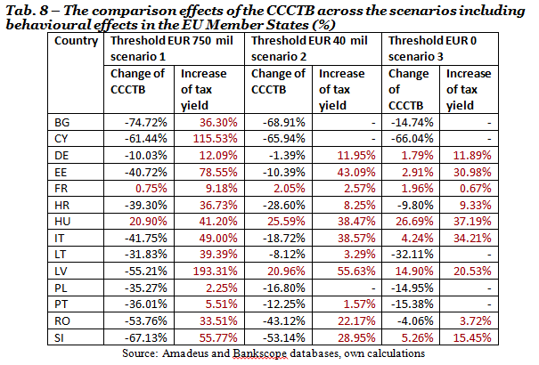
Conclusion – impact of Brexit
Impacts on the individual tax-base under the CCCTB

Slide 9
Impact of Brexit
Brexit will have significant impact on tax-base sharing mechanism under CCCTB.
Before Brexit, 19 EU Member States would reach a higher tax base under the CCCTB compared to the current conditions.
After Brexit:
the positive change in the tax base → only 2-7 EU Member States depending on the researched scenario and the behavioral effects.
higher tax yield under the CCCTB could be reached → 9-14 EU Member States.

Slide 10
Thank you for your attention!
danuse.nerudova@mendelu.cz
veronika.solilova@mendelu.cz

