Slide 1


Slide 2

UCMR Mission
To shape and further develop Umeå’s
environment for microbial research
Core values are excellence,
interdisciplinarity, and collaboration

Slide 3

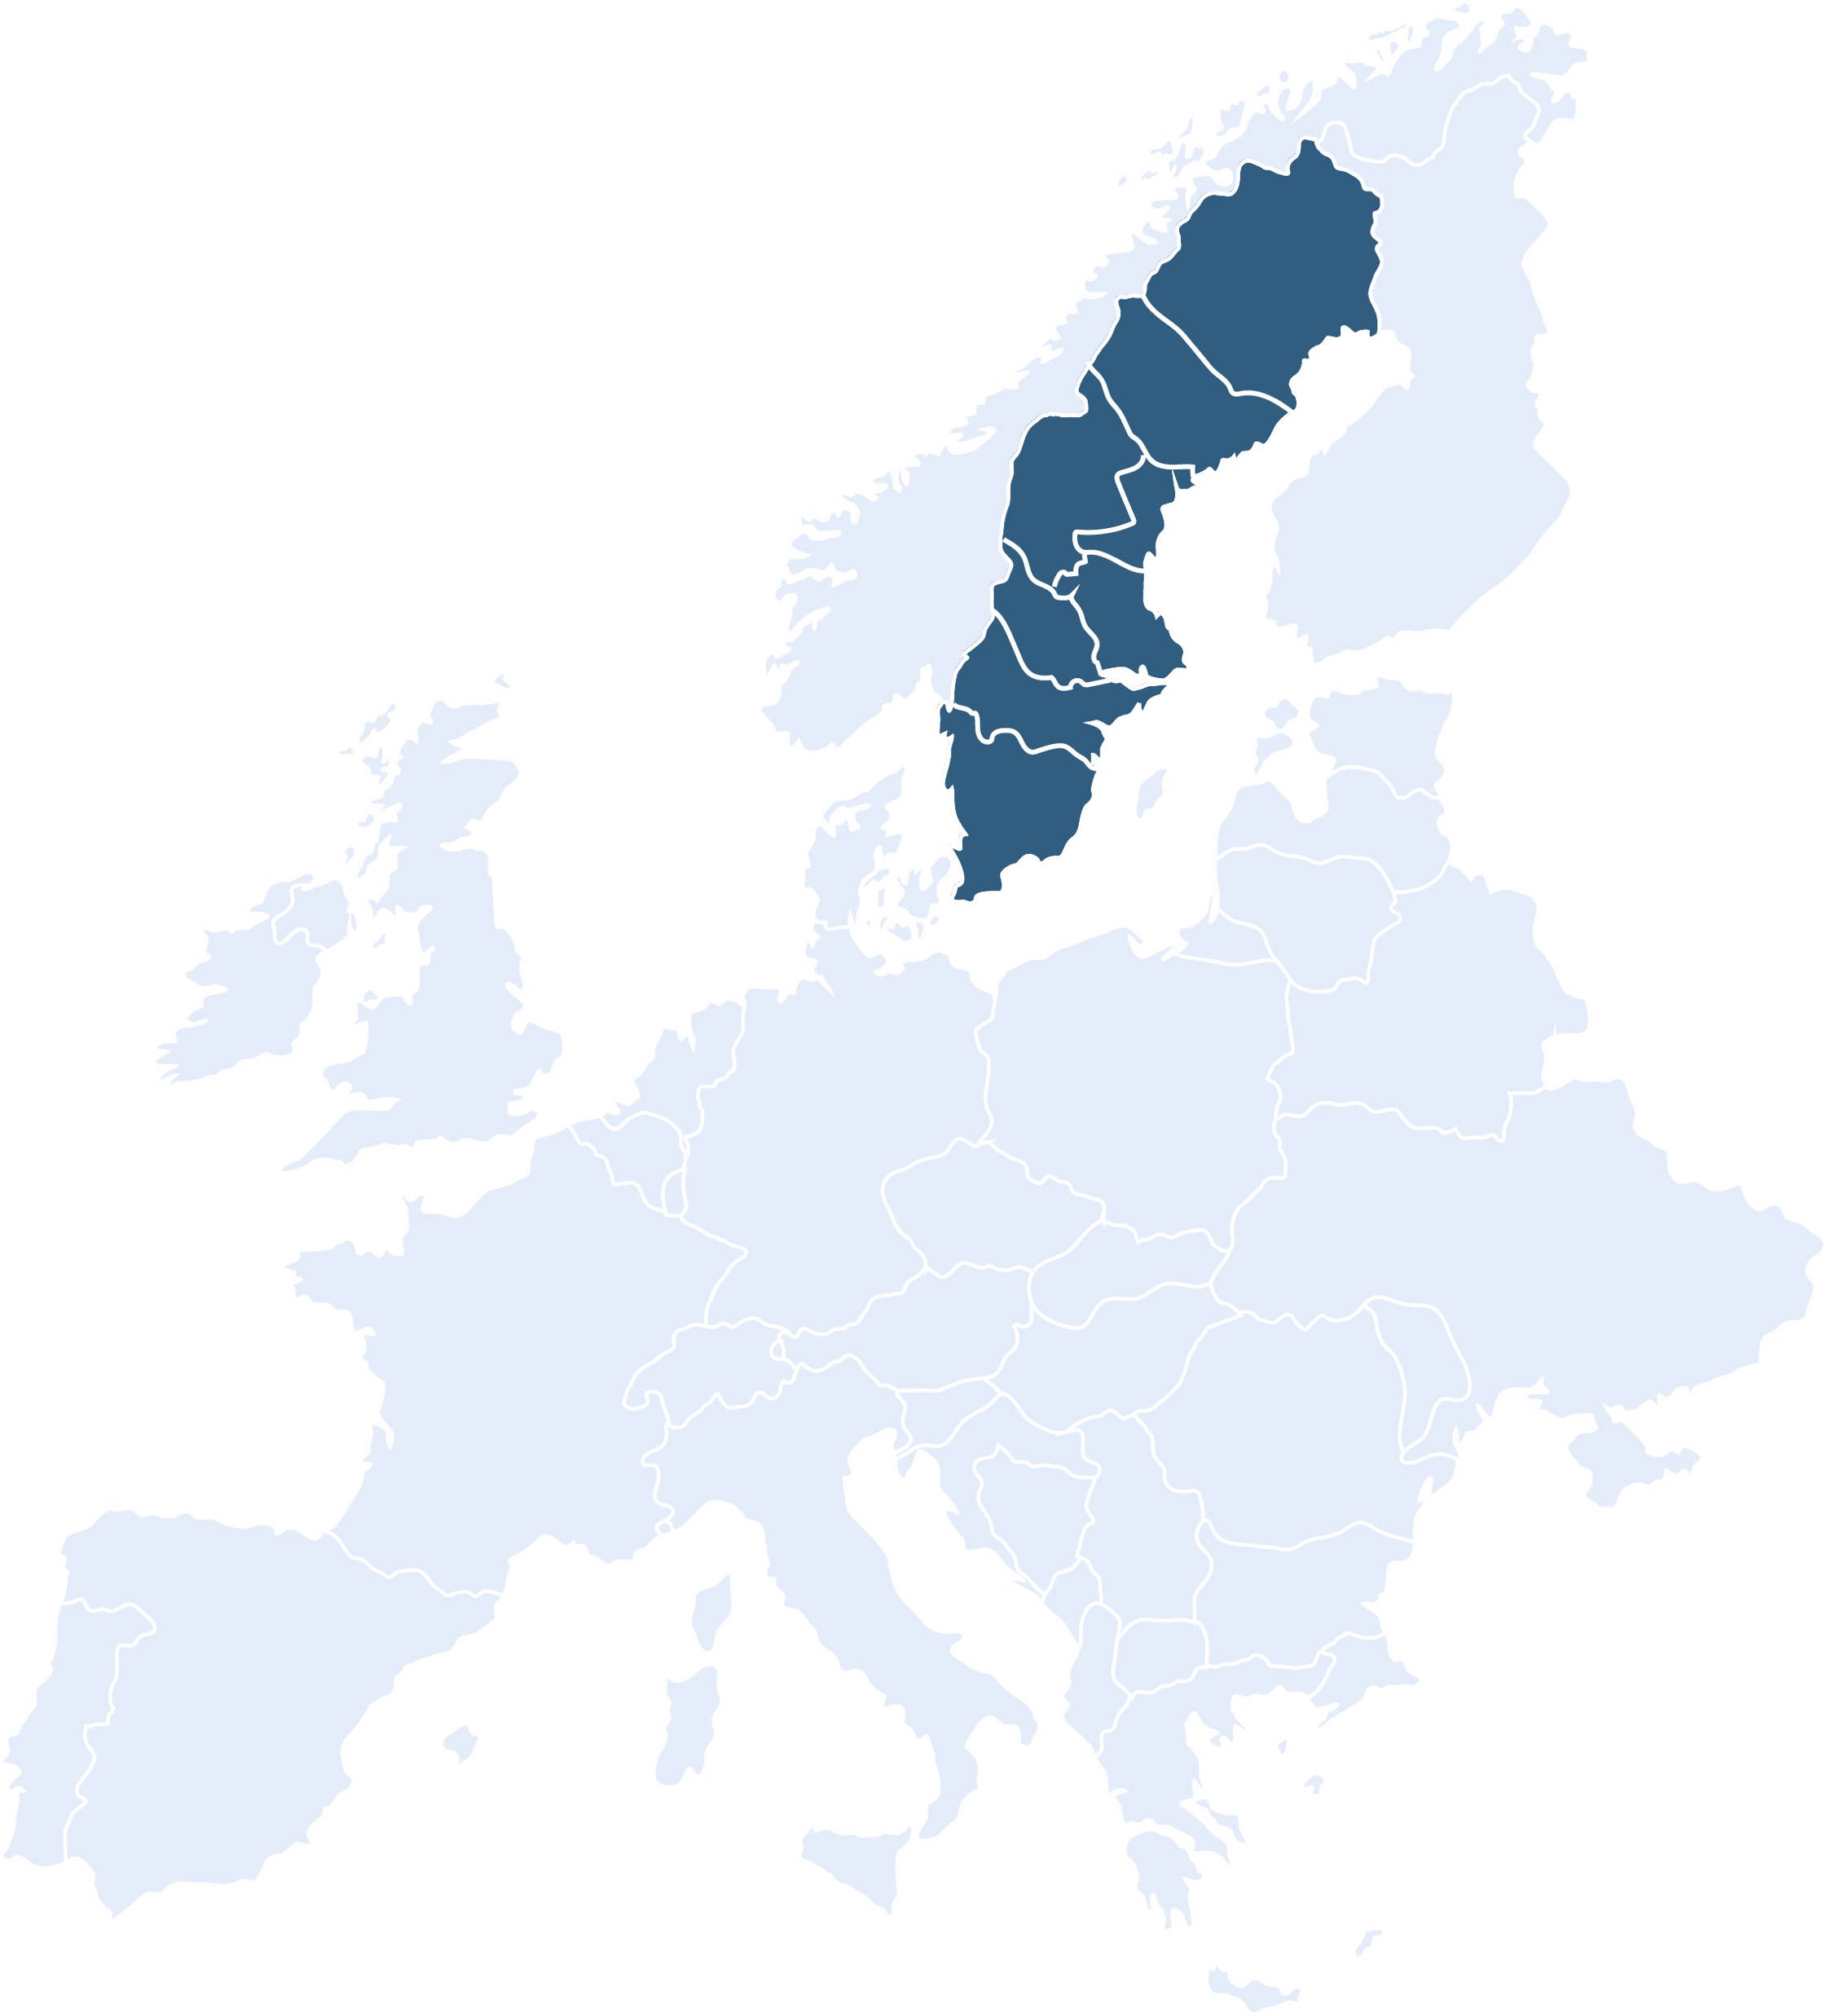

Very large network
77 research groups and more than 350 members
11 Departments
Biochemistry and Biophysics
Chemistry
Clinical Microbiology
Diagnostics and Interventions
Ecology and Environmental Sciences
Mathematics and Mathematical Statistics
Medical and Translational Biology
Molecular Biology
Odontology
Physics
Public Health and Clinical Medicine
2 Faculties
Science and Technology
Medicine
77
Research
Groups
UCMR
11
Departments
2
Faculties
MIMS
2 Centres

Slide 4

Networking opportunities for its members:
Annual conference, Annual retreat,
and thematic workshops
Crossing traditional boundaries to
work together:
New research collaborations through
Postdoc and PhD programmes
UCMR
Activities
Branding:
Communication of
Umeå’s microbial research
and outreach activities
Infrastructure:
Establishment of an
ABSL-3 laboratory in Umeå
Contributing to education of the next
generation microbial researchers:
National research schools in infection
International visibility:
Guest seminars, visiting scientist
programme, workshops and
conferences
Notes:
Blog, press releases, linkedin. I do visibility, education and branding.

Slide 5

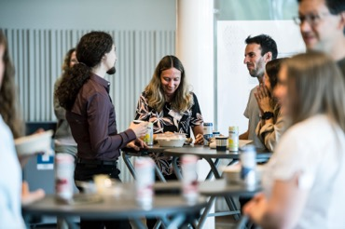
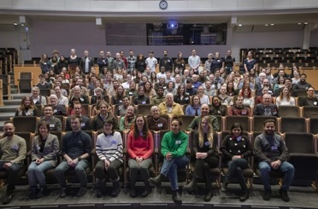
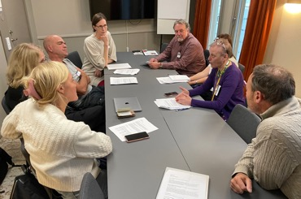
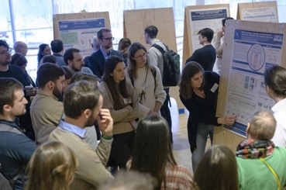
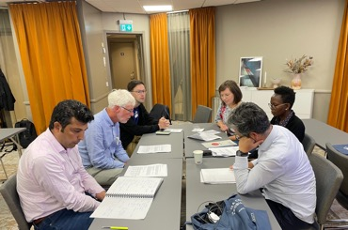
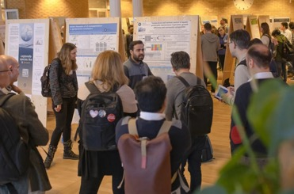
Networking opportunities for its members:
UCMR Day, PI Retreat, UCMR pub, and Young Academia

Slide 6
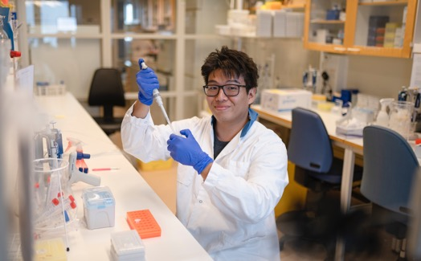
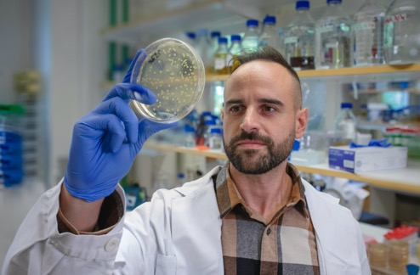
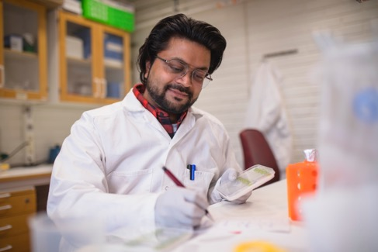
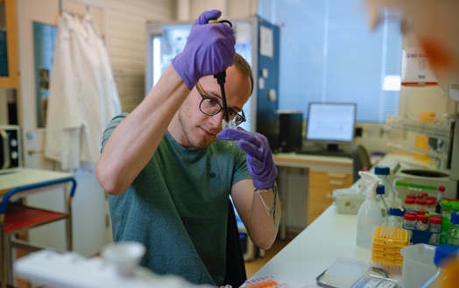
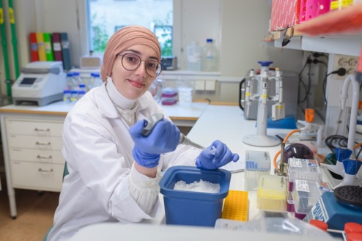
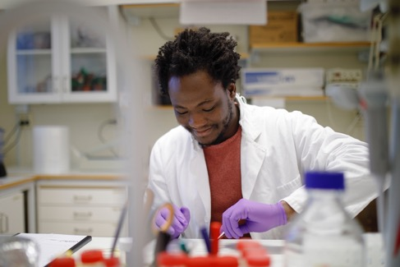
Crossing traditional boundaries between disciplines to work together:
New collaborations through ’EC’ Postdoc programme and translational PhD school

Slide 7
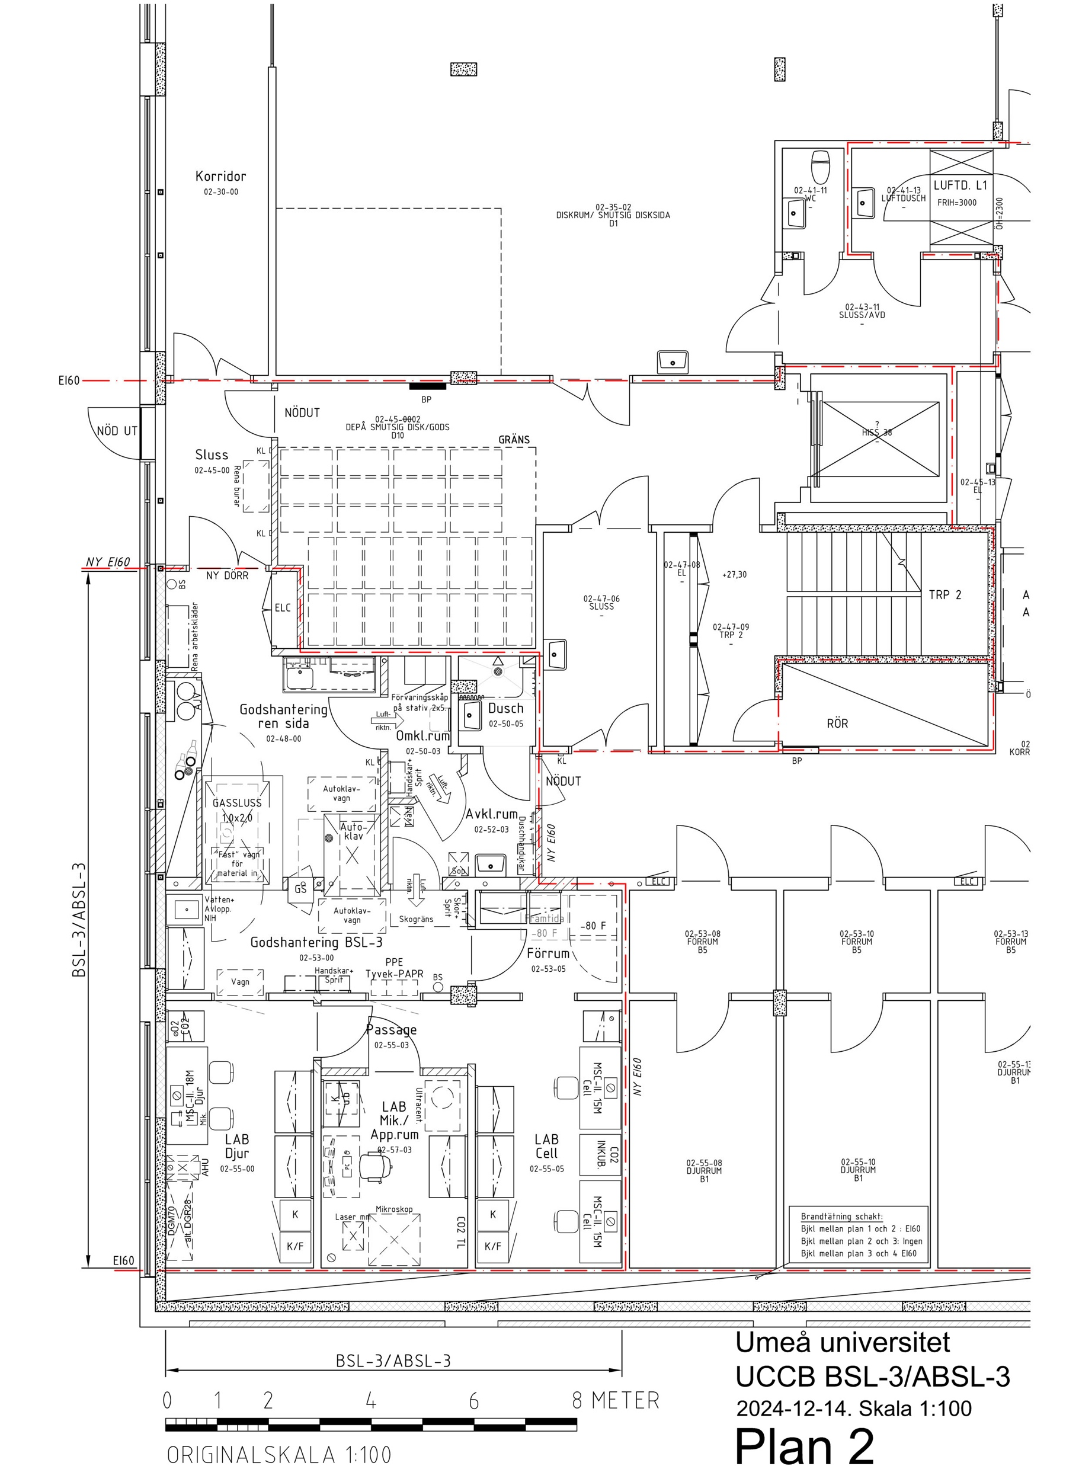
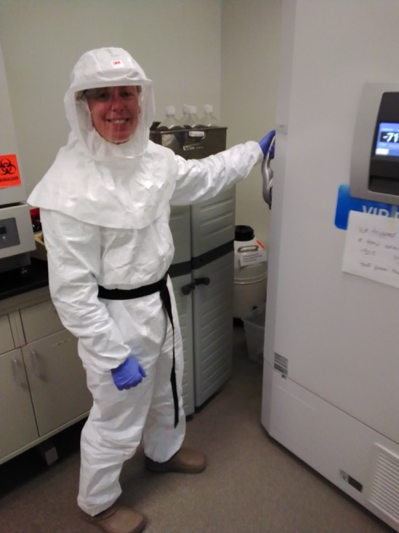
Infrastructure:
Establishment of an ABSL-3 laboratory - in vitro, advanced microscopy, animal work

Slide 8
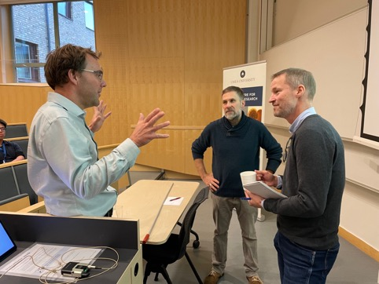
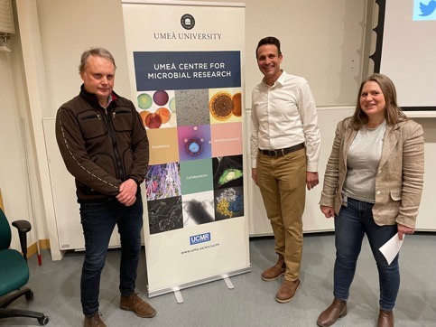
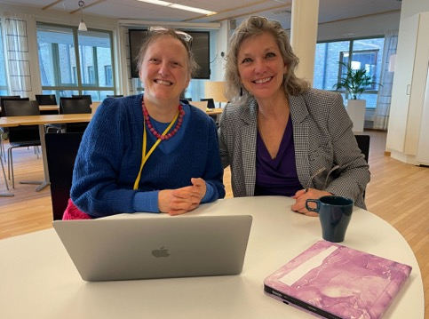
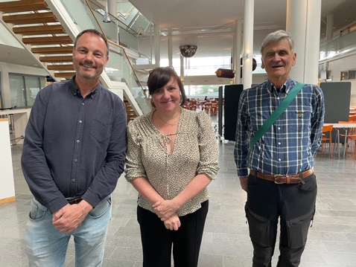
International visibility:
Guest seminars, visiting scientist programme, workshops, and conferences
MedChem Seminar Series
  Targets biophysics – biochemistry – chemistry oriented audience
SSIBS@UmU
  Targets a biology – medicine – clinically oriented audience
Notes:
Seminar Series for Integrated Biomedical Sciences

Slide 9
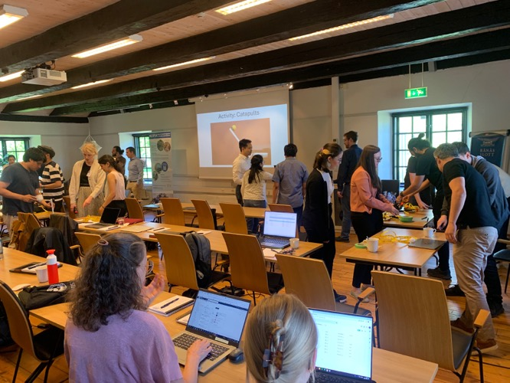
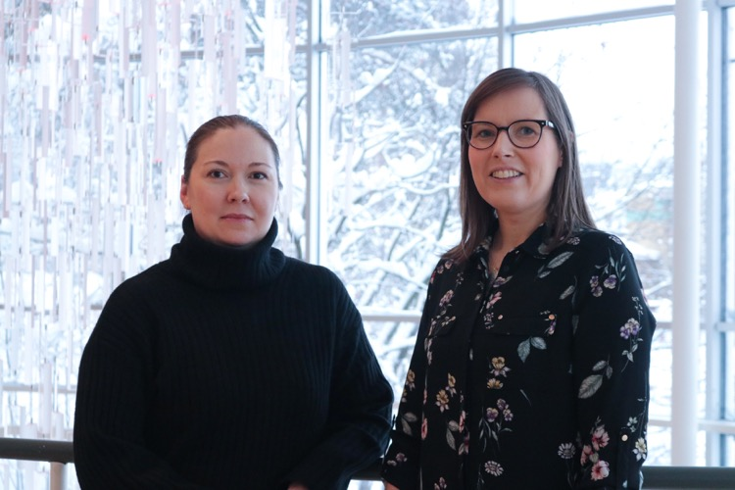
Contributing to education of the next generation of microbial researchers:
National research schools in infection and antimicrobials, NDPIA
National research school in viruses and pandemics, NDP-VIP

Slide 10
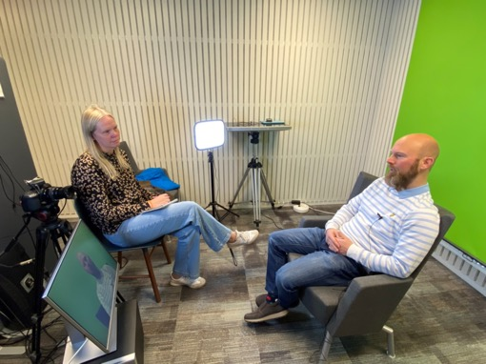
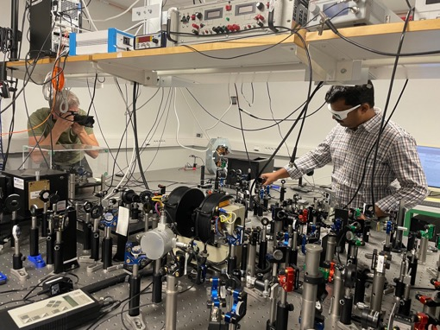
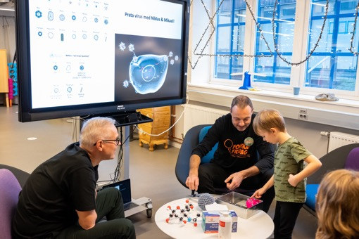
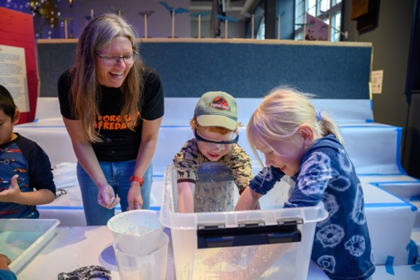
UCMR branding:
Communication through press releases, features, blog, social media, outreach activities
Notes:
Blog, press releases, linkedin.

Slide 11





Umeå University microbial research – History and milestones
“Bottom-up”
initiative UCMR
UCMR appointed Linnaeus
Center of Excellence
NDPIA research
school
Nobel prize in Chemistry
to Emmanuelle Charpentier
Mastering microbial
infections UMU
2004
2007
2008-18
2009-13
2014-24
2015
2020
2022-27
2024
2025
UCMR & MIMS
launched
Molecules for
the future
WCMM
launched
DDLS
launched
“Excellence by Choice”
postdoc programme
National research schools in infection launched
UCMR evaluated
“The jewel in the crown”

