Slide 1




Small Animal Research Imaging Facility (SARIF) at UCCB
SARIF infrastructure consists of five non-invasive imaging equipment that have been acquired through financing from the Medical Faculty at UmU and external funding sources (e.g., Kempe foundation, Swedish Research Council, Wallenberg foundation) and are available to all researchers at UmU as well as to external users. The facility’s non-invasive modality complies with the 3R principle by providing high quality multimodal data acquisition, reducing suffering and decreasing the number of animals required and thus provides an important facet of animal welfare at Umeå University. The equipment are located at UCCB.
Equipment managed by SARIF
9.4T BioSpec 94/20 high field small animal MRI scanner from Bruker
NanoScan hybrid PET/CT from Mediso
Ultrasound - Vevo 2100 system from FUJIFILM VisualSonics
EchoMRI™-130 Body Composition Analyzer for Mice and Organs from EchoMRI
In Vivo Imaging System (IVIS®Spectrum) from Perkin Elmer®
For more information contact:
fahad.sultan@umu.se
daniel.marcellino@umu.se

Slide 2
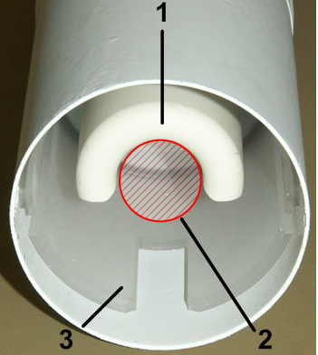
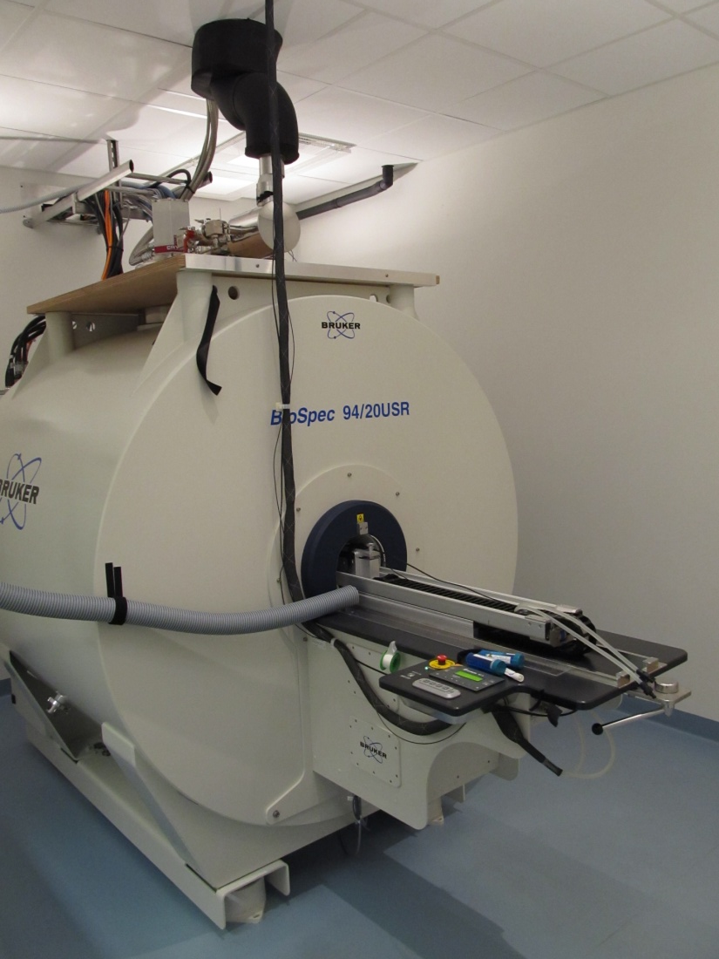
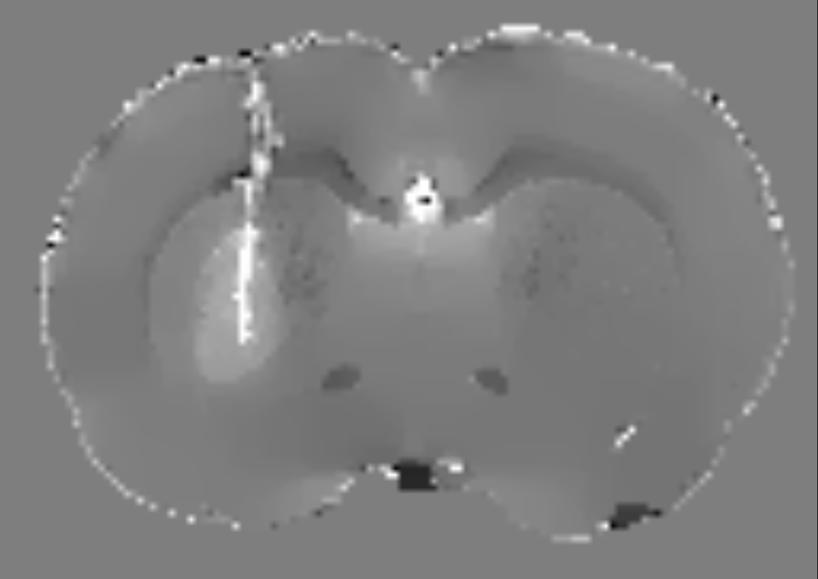
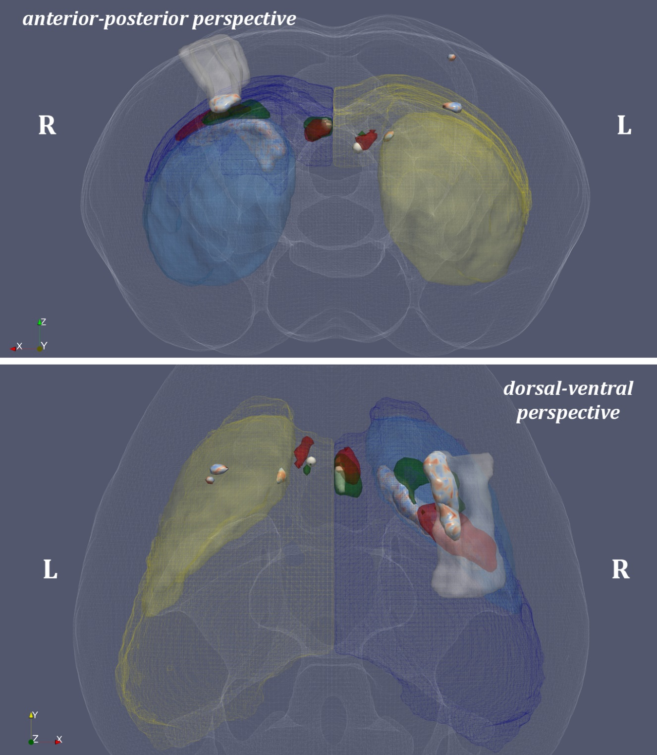
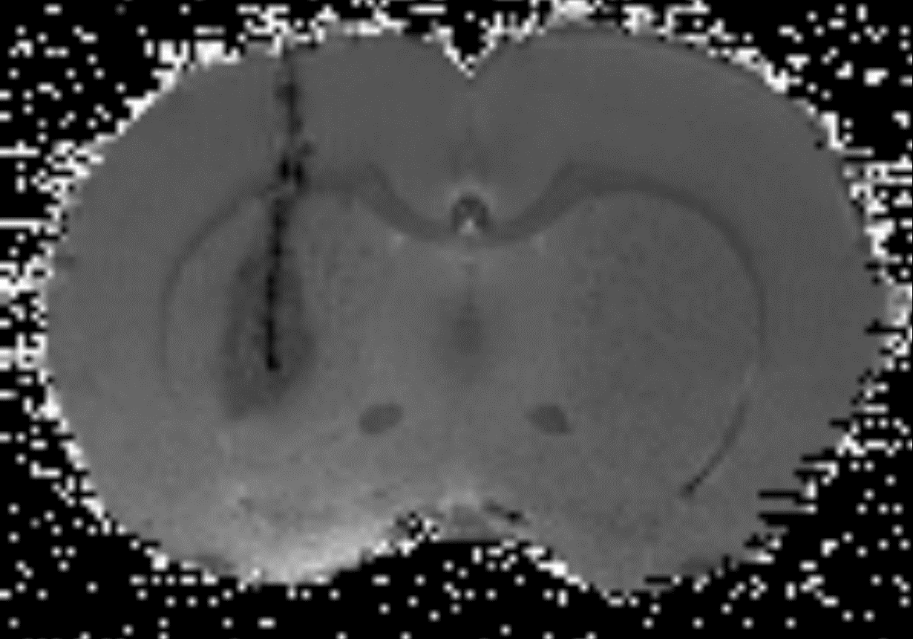
9.4T BioSpec 94/20 high field MRI at UCCB
Magnetic resonance imaging (MRI) is widely used in human diagnostics due to its non-invasive nature and due to its ability to yield important information about the structure and function of different organs (e.g. nervous tissue, heart, pancreas and tendon/muscles). This also makes it ideal for translational and non-invasive animal research. SARIF has a state of the art 9.4T with a bore of 20 cm allowing for small animal structural and functional imaging.
CURRENT PROJECTS
Diffusion weighted imaging of peripheral nerves using tractography to study nerve regeneration in rats
Long-term longitudinal functional (resting-state) and structural (DTI) MRI to study mice brain network aging
Longitudinal monitoring of cortical plasticity in a motor learning task in mice using myelin enhanced imaging
Longitudinal MRI-DTI monitoring of neurodegeneration in a mouse model of ALS
Parkinson’s disease and Iron accumulation in the rat brain
Cryocoil (1) with the sensitive volume indicated (2). The coil is cooled to -250ºC in order to reduce the thermal noise, while the outer part of the coil is kept at 37ºC.
The 9.4T MRI scanner at SARIF is capable of scanning tissue specimen (ex-vivo) and small animals in-vivo (mice and rats). A selection of coils is available to scan whole body, or at larger detail rat and mouse brain and heart (volume and array coils). Array coils also allow accelerated image acquisition used for cardiac and functional brain imaging. Surface coils are used for scanning small and well-defined regions of interest of the animal. The cryogenically cooled coil is used for scanning mouse brain, heart and spine and gives approximately 3 times higher signal-to-noise ratio, compared to room temperature coils.
For more information contact:
fahad.sultan@umu.se
daniel.marcellino@umu.se
Longitudinal MRI-DTI monitoring of neurodegenertion in ALS see -> Tomas Mediavilla poster

Slide 3
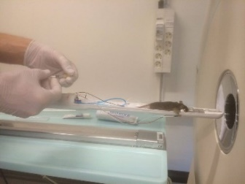
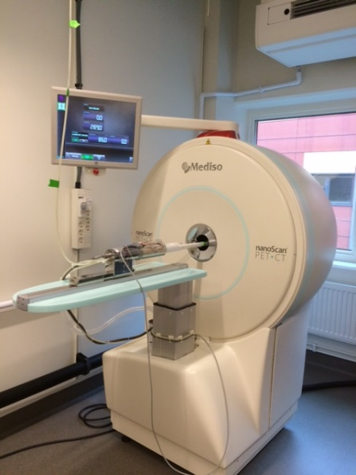
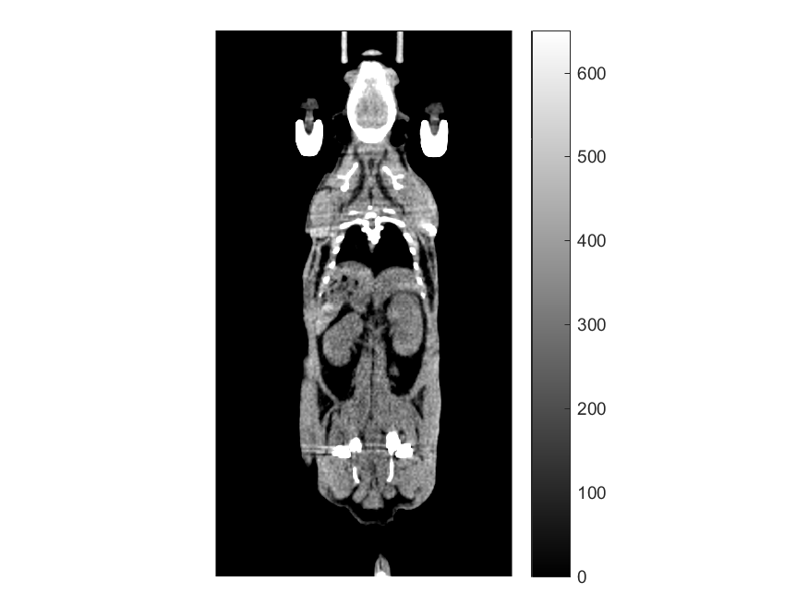
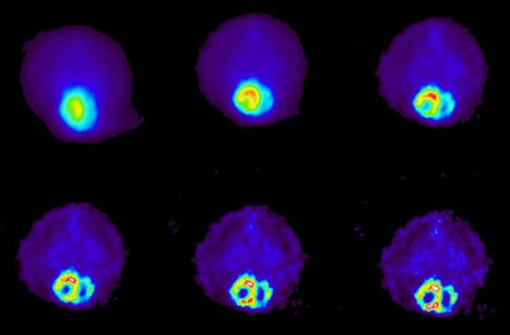
PET-CT at UCCB
Positron Emission Tomography (PET) is a tool for non-invasive quantification, such as tissue metabolic activity or receptor binding, using functional molecules labelled with positron-emitting radioisotopes.
The dual modality nanoScan PET-CT gives the possibility to study both molecular function and anatomy.
The scanner can be used for objects up to 8 cm in diameter, and 45 cm long. The PET-scanner has a submillimeter resolution and the CT has a resolution > 30 micro meters.
It is possible to perform dynamic PET scanning with subsequent pharmacokinetic analysis and binding potentials.
We offer aid in planning and experimental set up, as well as evaluation of data.
Molecule | Function
11C-SCH23390 | D1 receptor
11C-Raclopride | D2 receptor
11C-Acetate | Acetyl-CoA, metabolism, lipid creation
18F-PE2I | DAT transport
18F-FDG | Glucose metabolism
18F-FTHA | Fatty acid metabolism
18F-FLT | Proliferation
18F-NAF | Vascular microcalcifikation, osteoblast activity
68Ga-DOTATOC | Somatostatin receptors
18F-PSMA | Prostate specific membrane antigene
CT of mouse.
18F-PE2I/ Dopamin uptake in rat brain.
Dynamic uptake of 18F-glucose in mouse heart.

Slide 4
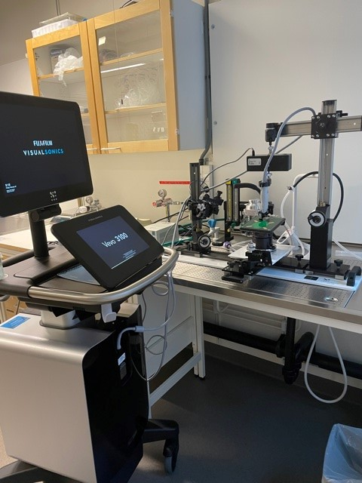
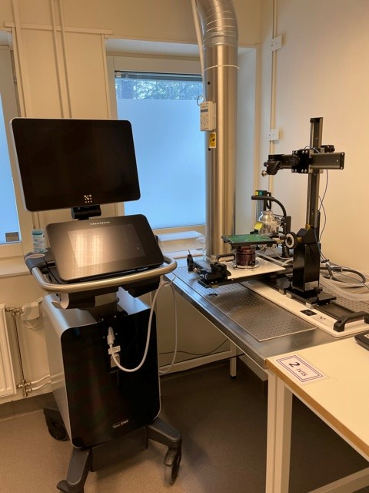
High-resolution Ultrasound, Vevo 3100 system at UCCB
The Vevo 3100 system is a high-frequency ultrasound imaging platform excellent for estimating in vivo cardiac function, examining abdominal organs and analysing volume and development of abdominal mass (e.g. cysts and tumors) in small experimental animals. It has an integrated adjustable rail system, heating plate and anaesthesia customized for handling small animal. It can be used for guided injections and introducing contrast labelled microbubbles for enhanced visualization.
Tumor size can be measured in either 2D or 3D mode.
Cardiac function uses B-mode or M-mode.
Blood flow velocities can be measured by doppler and visualized by color doppler.
Vascular function can be estimated by pulsatility or resistive index.
RF-mode is available for liver fat content.
Two systems are available at UCCB,
one located at Open A unit, and
one at the infectious unit. Both systems are equipped with MX440 and MX550D linear array transducers suitable for cardiovascular, abdominal and embryology imaging.

Slide 5
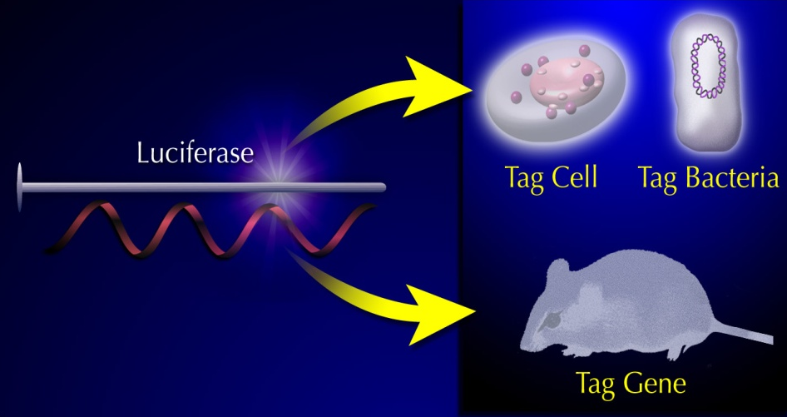
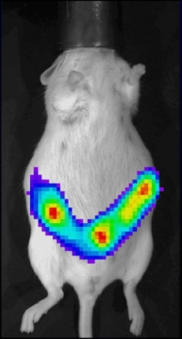
Real-time imaging using In Vivo Imaging Systems (IVIS) at UCCB
In vivo optical imaging is a powerful technique that measures light produced by biological or chemical moieties
Optical, non-invasive imaging of ongoing biological processes in small laboratory animals
Allows studies of molecular and biological processes of disease, gene activation, infection progression, and drug candidate evaluation.
Light producing optical reporters; luciferase, fluorescent proteins
Cancer cell lines
Infectious agents
Animals (transgenic mice and rats)
Tracer Applications: Amount of light is proportional to number of cells
Functional Applications: Light is produced in response to a stimulus
IVIS Spectrum and XGI-8 anesthesia System @UCCB offers
High Sensitivity in vivo fluorescence and bioluminescence imaging
2D optical imaging (bioluminescence and fluorescence)
3D optical tomography for bioluminescence & fluorescence imaging
Images 5 mice simultaneously

Slide 6
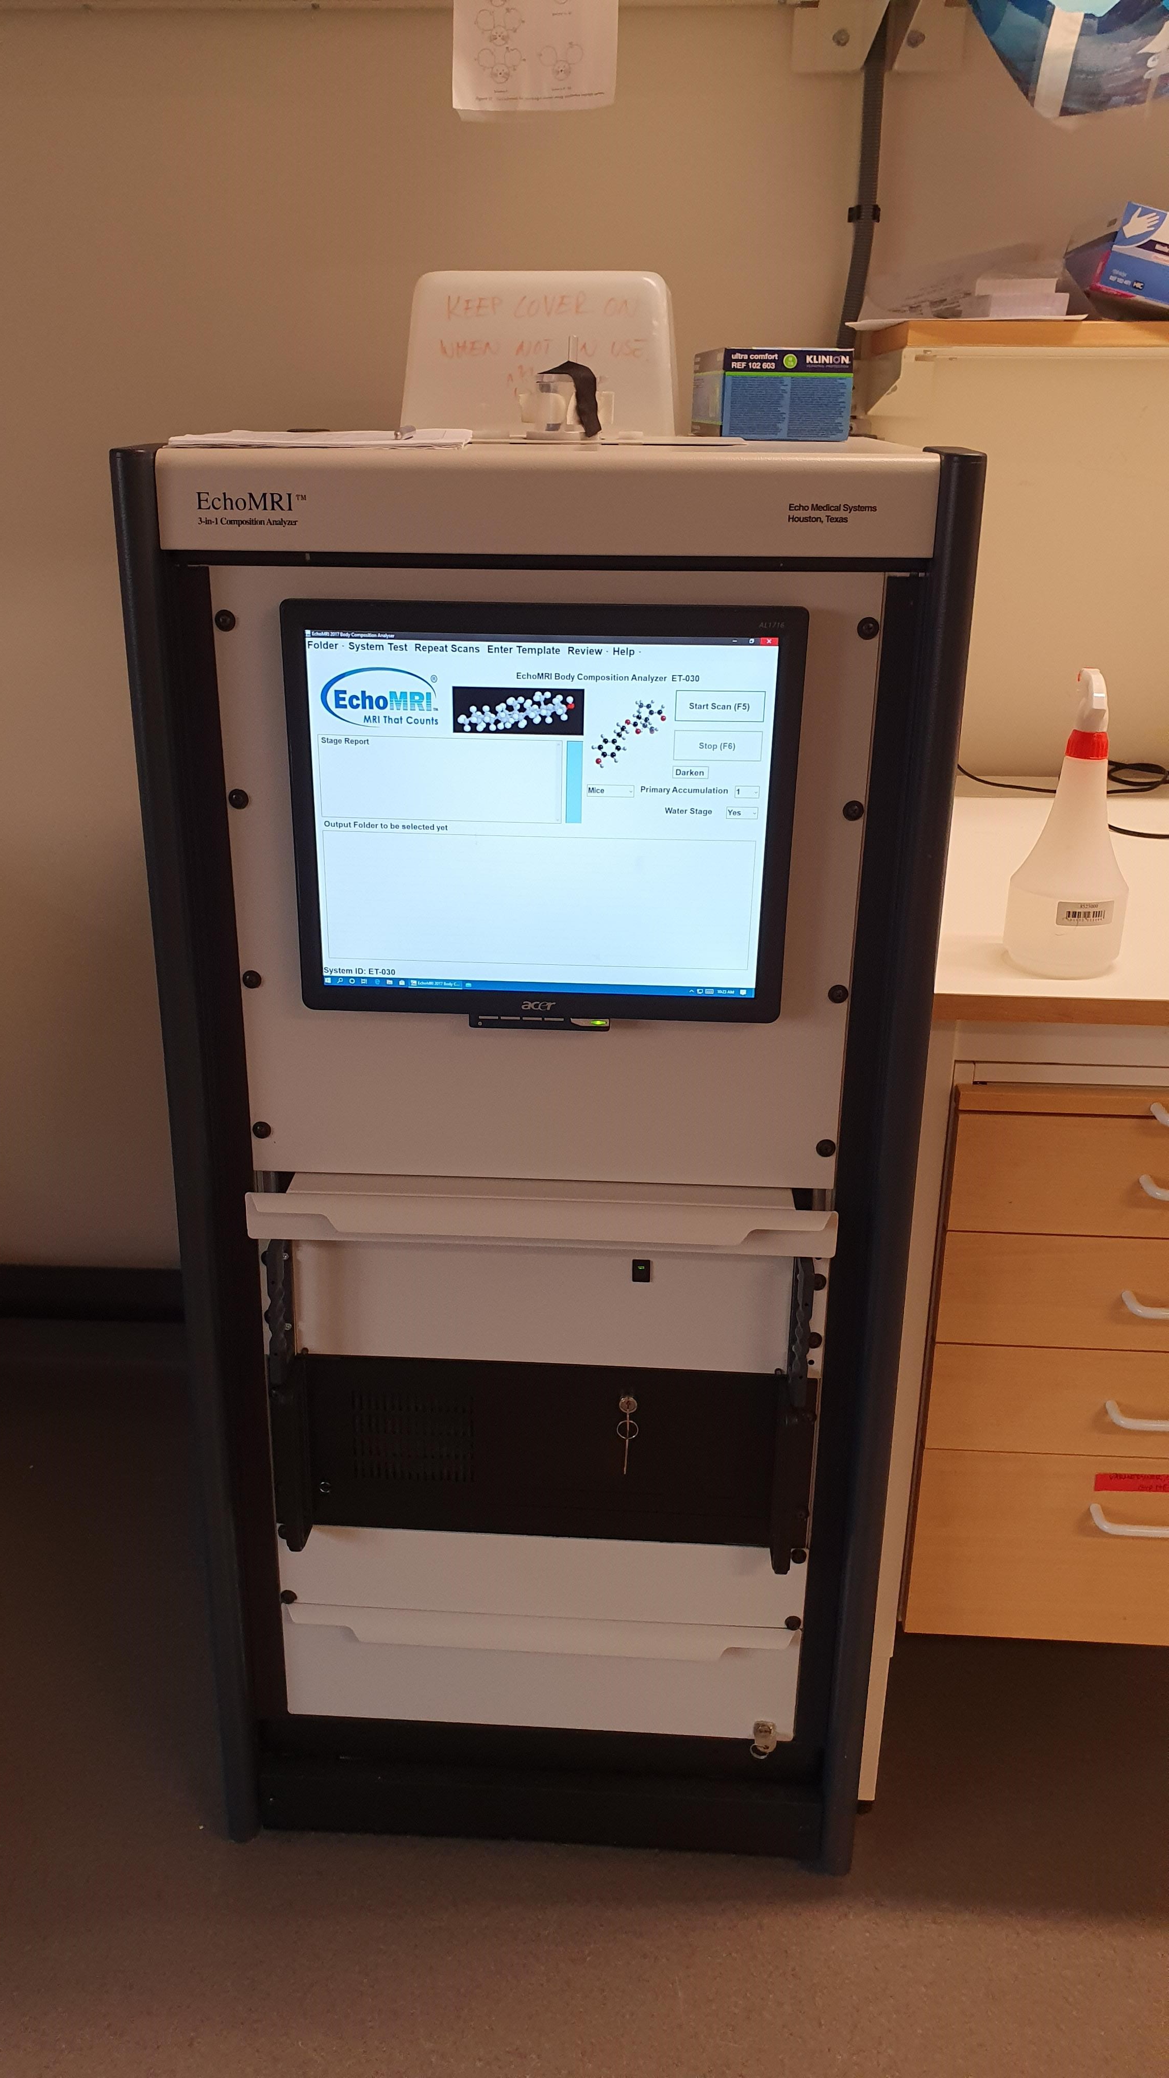
EchoMRI™-130 Body Composition Analyzer for Mice at UCCB
The EchoMRI™-130 Analyzer delivers precise body composition measurements of fat, lean,
free water, and total water mass in live animals. EchoMRI™ Analyzers are exceedingly easy
to operate in which a training period of only one hour is sufficient for SARIF users without any
prior knowledge of the equipment. Numeric results are stored and can be later viewed at any
time.
In vivo measurement of fat content in animals (<130g), or tissue.
Non-invasive
Requires no anaesthesia or preparation.
< 2 minutes per animal.

